Slide 1


KARNAVATI UNIVERSITY
Unitedworld Institute of Technology
E-Health Care System
Professional Training
Semester: 4th
Programme: B. Sc. (Hons.)
Guided by:
Ms. Rama M. Maliya and Mr. Sanjay Ajani
Assistant Professor
UIT, KU
Prepared by:
Dimple Tolani(20220701052)

Slide 2




FRONT END
TECHNOLOGY
HTML
CSS
JavaScript
BACKEND
TECHNOLOGY
SQLite3
Flask

Slide 3

PROJECT
Functionalities
User login
Account Personalization
Interactive and Responsive
Email Verification
Public Search for user accounts

Slide 4
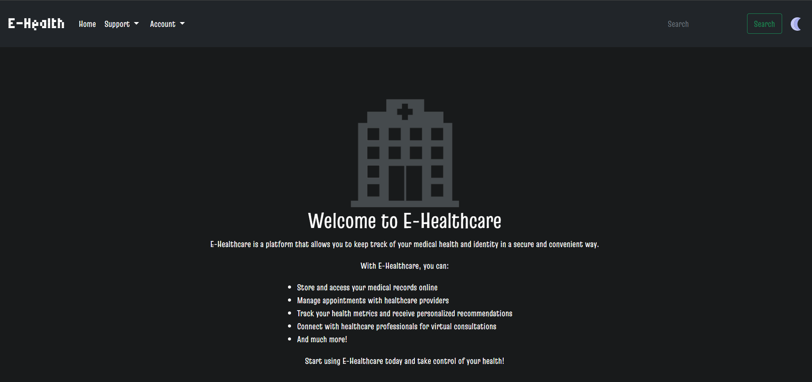
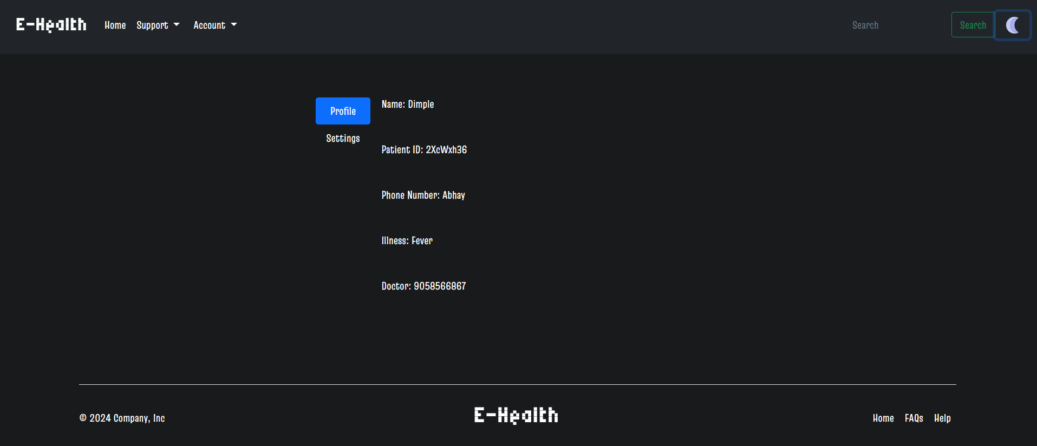
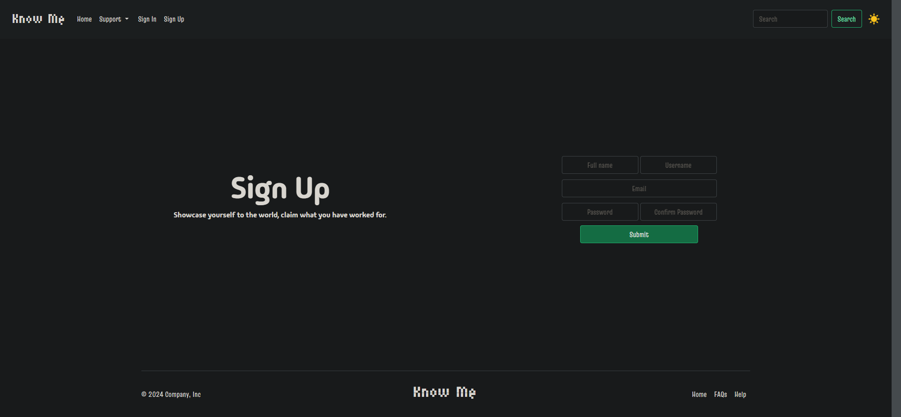
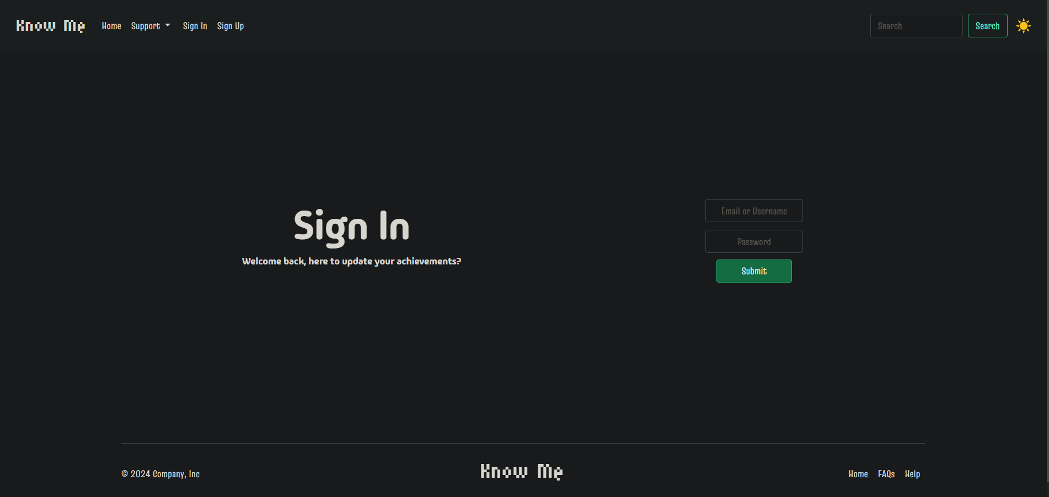
PROJECT
Screenshots

Slide 5
PROJECT LINK
GitHub Link:
OR
Drive Link:

Slide 6
THANK YOU

